Slide 1
EV PROJECT
AUTOMATION TEAM

Slide 2
INTRODUCTION
An autonomous car is a vehicle capable of sensing its environment and operating without human involvement.
Autonomous cars rely on sensors, actuators, complex algorithms, machine learning systems, and powerful processors to execute software.
Today, Tesla, Google, Uber, and General Motors are all trying to create their own self-driving cars that can run on real-world roads.
Autonomous cars create and maintain a map of their surroundings based on a variety of sensors situated in different parts of the vehicle. Radar sensors monitor the position of nearby vehicles. Video cameras detect traffic lights, read road signs, track other vehicles, and look for pedestrians. Lidar (light detection and ranging) sensors bounce pulses of light off the car’s surroundings to measure distances, detect road edges, and identify lane markings. Ultrasonic sensors in the wheels detect curbs and other vehicles when parking.
Sophisticated software then processes all this sensory input, plots a path, and sends instructions to the car’s actuators, which control acceleration, braking, and steering. Hard-coded rules, obstacle avoidance algorithms, predictive modeling, and object recognition help the software follow traffic rules and navigate obstacles.

Slide 3
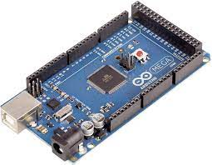
KEY COMPONENTS
Arduino mega
The Arduino Mega 2560 is a microcontroller board based on the ATmega2560. It has 54 digital input/output pins (of which 15 can be used as PWM outputs), 16 analog inputs, 4 UARTs (hardware serial ports), a 16 MHz crystal oscillator, a USB connection, a power jack, an ICSP header, and a reset button.

Slide 4
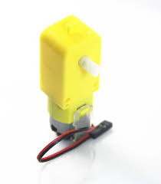
DC motor
DC motors are rotary electrical machines that convert electrical energy into mechanical energy (Rotation).

Slide 5
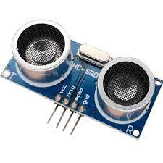
Ultrasonic sensor
An ultrasonic sensor is an instrument that measures the distance to an object using ultrasonic sound waves. An ultrasonic sensor uses a transducer to send and receive ultrasonic pulses that relay back information about an object’s proximity. High-frequency sound waves reflect from boundaries to produce distinct echo patterns.

Slide 6
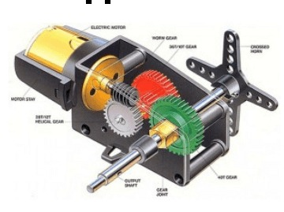
Servomotor
A servomotor is a rotary actuator or linear actuator that allows for precise control of angular or linear position, velocity and acceleration. It consists of a suitable motor coupled to a sensor for position feedback.

Slide 7
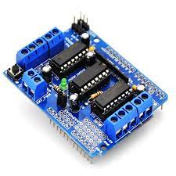
Motor shield
The Arduino Motor Shield allows you to easily control motor direction and speed using an Arduino. By allowing you to simply address Arduino pins, it makes it very simple to incorporate a motor into your project. It also allows you to be able to power a motor with a separate power supply of up to 12v.

Slide 8
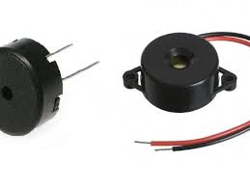
Buzzer- It is basically a tiny speaker that you can connect directly to an Arduino. You can make it sound a tone at a frequency you set. The buzzer produces sound based on reverse of the piezoelectric effect. It is also known as piezo buzzer.

Slide 9
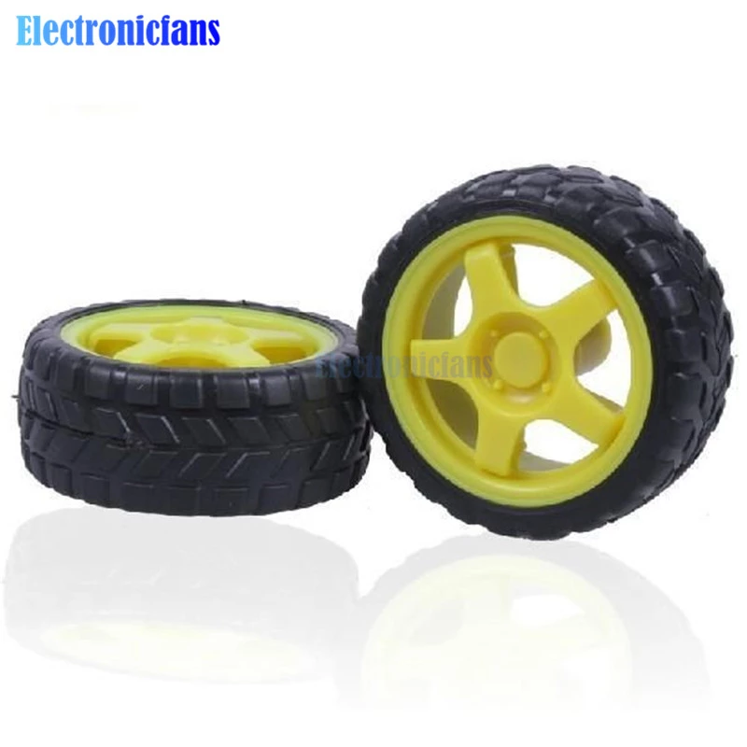
Wheels- helps the robot to navigate around the ground and to propel itself.

